Slide 1
Detecting and Visualizing Future-related Text Content
Innsbruck, 02.05.2023
Juwal Regev
Supervised by: Prof. Adam Jatowt

Slide 2
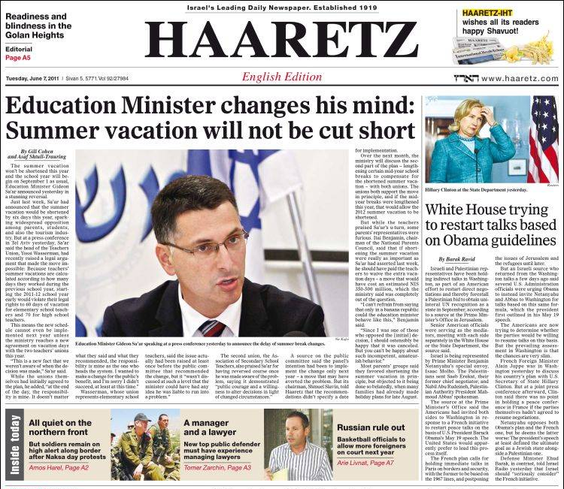
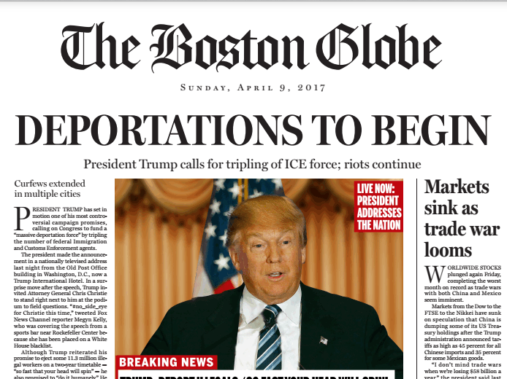
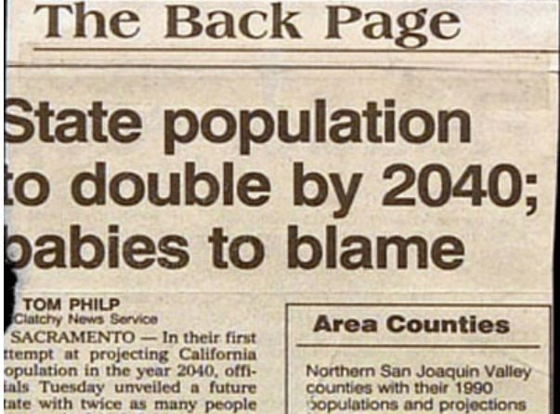
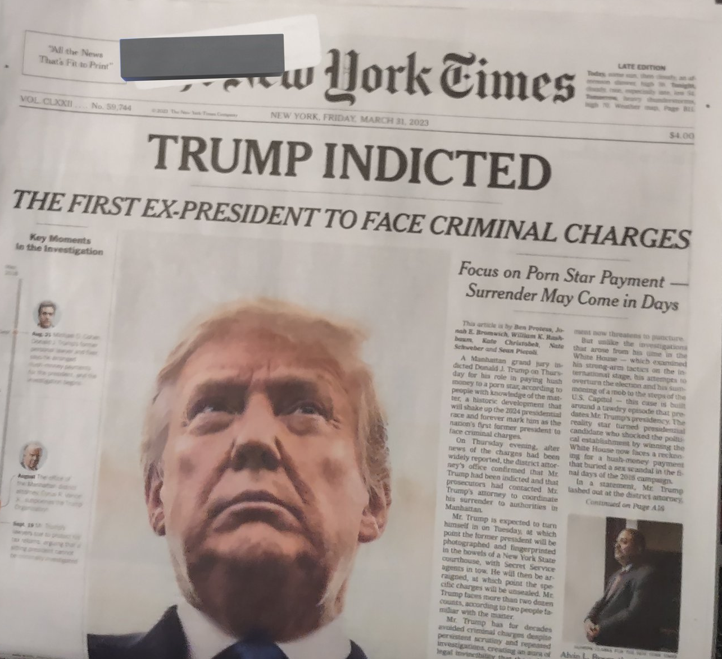
Introduction
many articles published every day
contain information about the future
upcoming product launches,
sports matches,
political announcements,
…
useful information for anticipating or preparing for future events
provides overview of what the future holds for some entity.

Slide 3
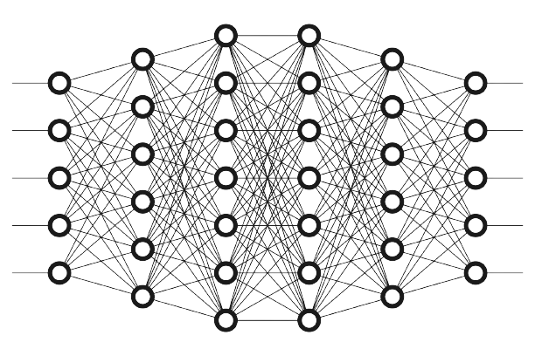

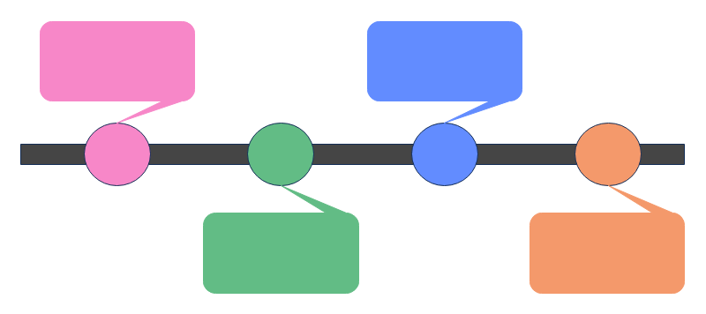
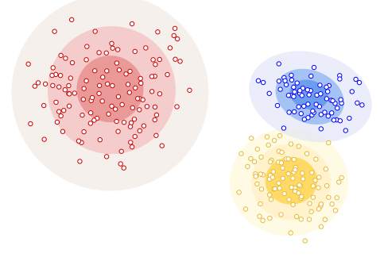
System - Overview
Query: Elon Musk
[1]
download articles
extract sentences
[2]
take positives
classify sentences
Topic 1: spacex – launch - rocket - starship
Topic 2: elon – visit - china - april
Topic 3: twitter – open source - code - release
[3]
[4]
create timeline of sentences containing temporal expressions
cluster future related sentences
extract topic keywords

Slide 4
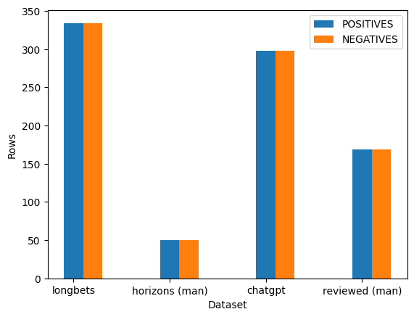
Goal #1: Create Multi-Sourced Dataset
should be from multiple different sources
~4000 positives & ~4000 negatives
sentences should have different structure/words
eg. not all 'will'

Slide 5
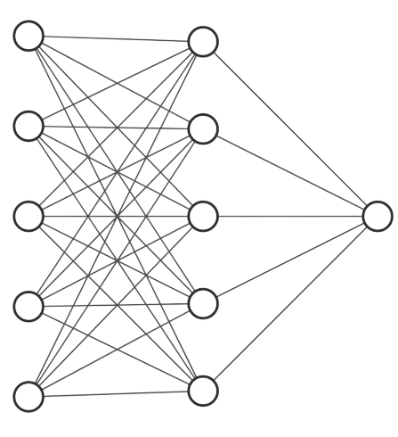
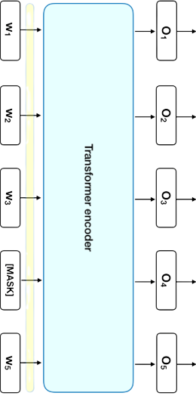
Goal #2: Fine-tune RoBERTa
pre-trained
fine-tuned
Mean-Pooling
RoBERTa Transformer-Encoder
[5]

Slide 6
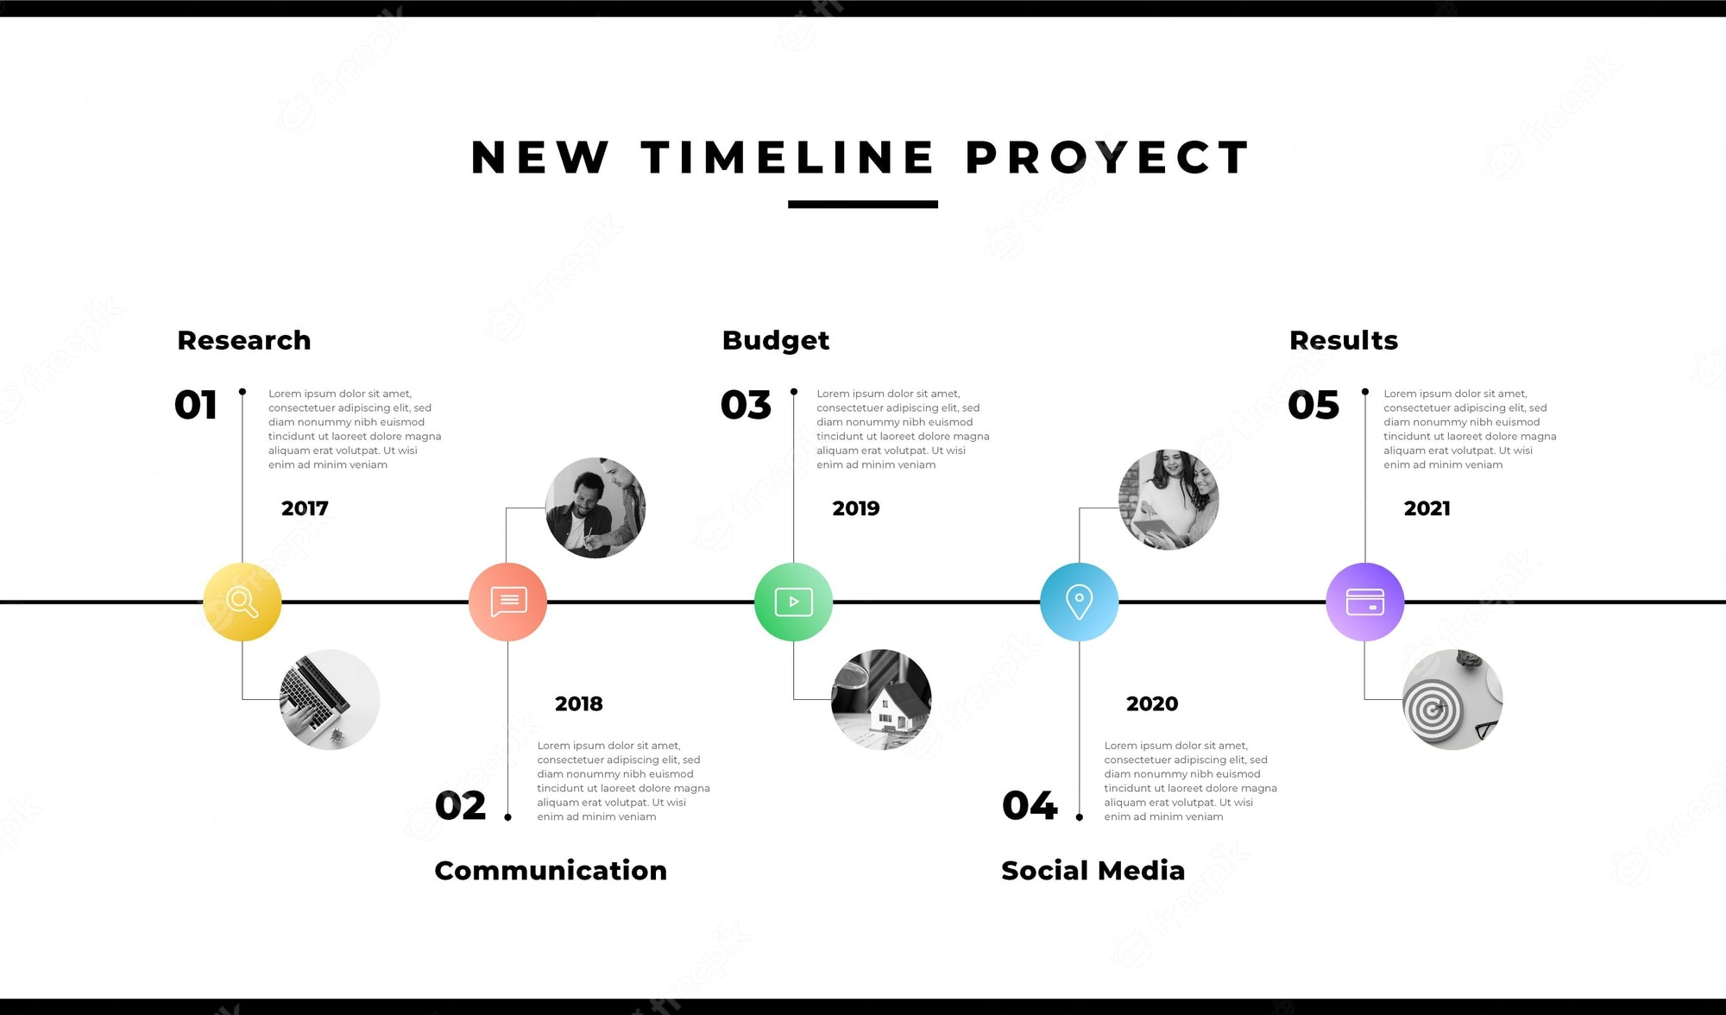
System - Overview
Query: Elon Musk
download articles
extract sentences
take positives
classify sentences
Topic 1: spacex – launch - rocket - starship
Topic 2: elon – visit - china - april
Topic 3: twitter – open source - code - release
Create timeline of sentences containing temporal expressions
cluster future related sentences
extract topic keywords

Slide 7
System - Overview
Query: Elon Musk
download articles
extract sentences
take positives
classify sentences
Topic 1: spacex – launch - rocket - starship
Topic 2: elon – visit - china - april
Topic 3: twitter – open source - code - release
Create timeline of sentences containing temporal expressions
cluster future related sentences
extract topic keywords

Slide 8
Goal #3: Clustering into topics
TWITTER-MUSK-OPEN SOURCE-CODE
Twitter owner Elon Musk, confirmed the move on Saturday, promising to publish more of the code in the next two weeks
Musk said that most of the recommendation algorithms will be made open source and the rest will follow.
SPACEX-LAUNCH-STARSHIP-FIRST
AI-LETTER-OPENAI-SYSTEMS-DEVELOPMENT
In three days we could see the launch of the rocket that will someday take astronauts to Mars.
The Super Heavy booster will attempt a landing in Texas near its launch site.
The Starship Super Heavy rocket launch test could happen as soon as next week.
Elon Musk has signed a letter from the Future of Life institute calling for a six-month hiatus in the development of AI.
In an open letter, the group said: 'Powerful AI systems should be developed only once we are confident that their effects will be positive'.

Slide 9
SPACEX-LAUNCH-STARSHIP-FIRST
In three days we could see the launch of the rocket that will someday take astronauts to Mars.
The Super Heavy booster will attempt a landing in Texas near its launch site.
The Starship Super Heavy rocket launch test could happen as soon as next week.
TWITTER-MUSK-OPEN SOURCE-CODE
Goal #4: Identify Sentences with Temporal Expressions
Twitter owner Elon Musk, confirmed the move on Saturday, promising to publish more of the code in the next two weeks.
Musk said that most of the recommendation algorithms will be made open source and the rest will follow.
AI-LETTER-OPENAI-SYSTEMS-DEVELOPMENT
Elon Musk has signed a letter from the Future of Life institute calling for a six-month hiatus in the development of AI.
In an open letter, the group said: 'Powerful AI systems should be developed only once we are confident that their effects will be positive'.

Slide 10
Goal #5: Visualize Sentences on Timeline
Published 02.04.2023
In three days we could see the launch of the giant rocket that Elon Musk plans will someday take astronauts to Mars.
Published 03.04.2023
Twitter owner Elon Musk, confirmed the move on Saturday, promising to publish more of the code in the next two weeks.
Published 02.04.2023
Elon Musk has signed a letter from the Future of Life institute calling for a six-month hiatus in the development of AI.
In three days we could see the launch of the giant rocket ...
Elon Musk […] calling for a six-month hiatus [..]
05.04.2023
17.04.2023
02.10.2023
[…] Elon Musk, confirmed […] publish code in the next two weeks.

Slide 11
Current Progress

Slide 12
increase dataset
output statistics to the frontend
enable user to make query
connect frontend to backend
write thesis
What's still to do

Slide 13
Sources
[1] https://img.myloview.com/stickers/newspapers-icon-outline-newspapers-vector-icon-for-web-design-isolated-on-white-background-400-239267931.jpg
[2] https://cdn-media-1.freecodecamp.org/images/11mpE6fsq5LNxH31xeTWi5w.jpeg
[3] https://developers.google.com/static/machine-learning/clustering/images/DistributionClustering.svg
[4] https://images.edrawmax.com/examples/blank-timeline-template/timeline7.png
[5] https://miro.medium.com/v2/resize:fit:876/0*ViwaI3Vvbnd-CJSQ.png

